Slide 1
BUCHAREST 2015
Cross infection and home intravenous therapy

Slide 2
Cross infection
Guidelines for patients with Cystic Fibrosis
Home intravenous therapy

Slide 3
Infection control
Why is infection control so important
What are the guidelines for patients
Guidelines for cleaning Nebulizers
How do we prevent cross infection in our CF population

Slide 4
The major cause of morbidity in cystic fibrosis is due to disease of the respiratory system which is characterized by progressive bronchiectasis and airflow obstruction
One of the main contributing factors to this progression is chronic bacterial infection
Early intervention and prevention of lung disease is of paramount importance

Slide 5
Principles of care (CF Thrust guidelines 2011)
Regular monitoring for cross infection and epidemiological surveillance should take by molecular typing
Patients with Cystic Fibrosis should have single en-suite rooms in order to minimise cross infection
Patients should not share toilets while in patient or a clinics
Segregation policies in hospitals should be implemented
Patients with BC MRSA AND MTN special precautions taken –admitted to separate wards and have segregated clinics
Hospital facilities must maintain a high standard of hygiene

Slide 6
How to achieve this
Early diagnosis of cystic fibrosis
Monitoring of clinical status
Early use of antibiotic courses with recurrent or continuous bacterial colonization
Chest physiotherapy
Various hygiene measures to prevent infection and cross infection
En-suite single rooms
Patient and family education
Education of Health professionals

Slide 7
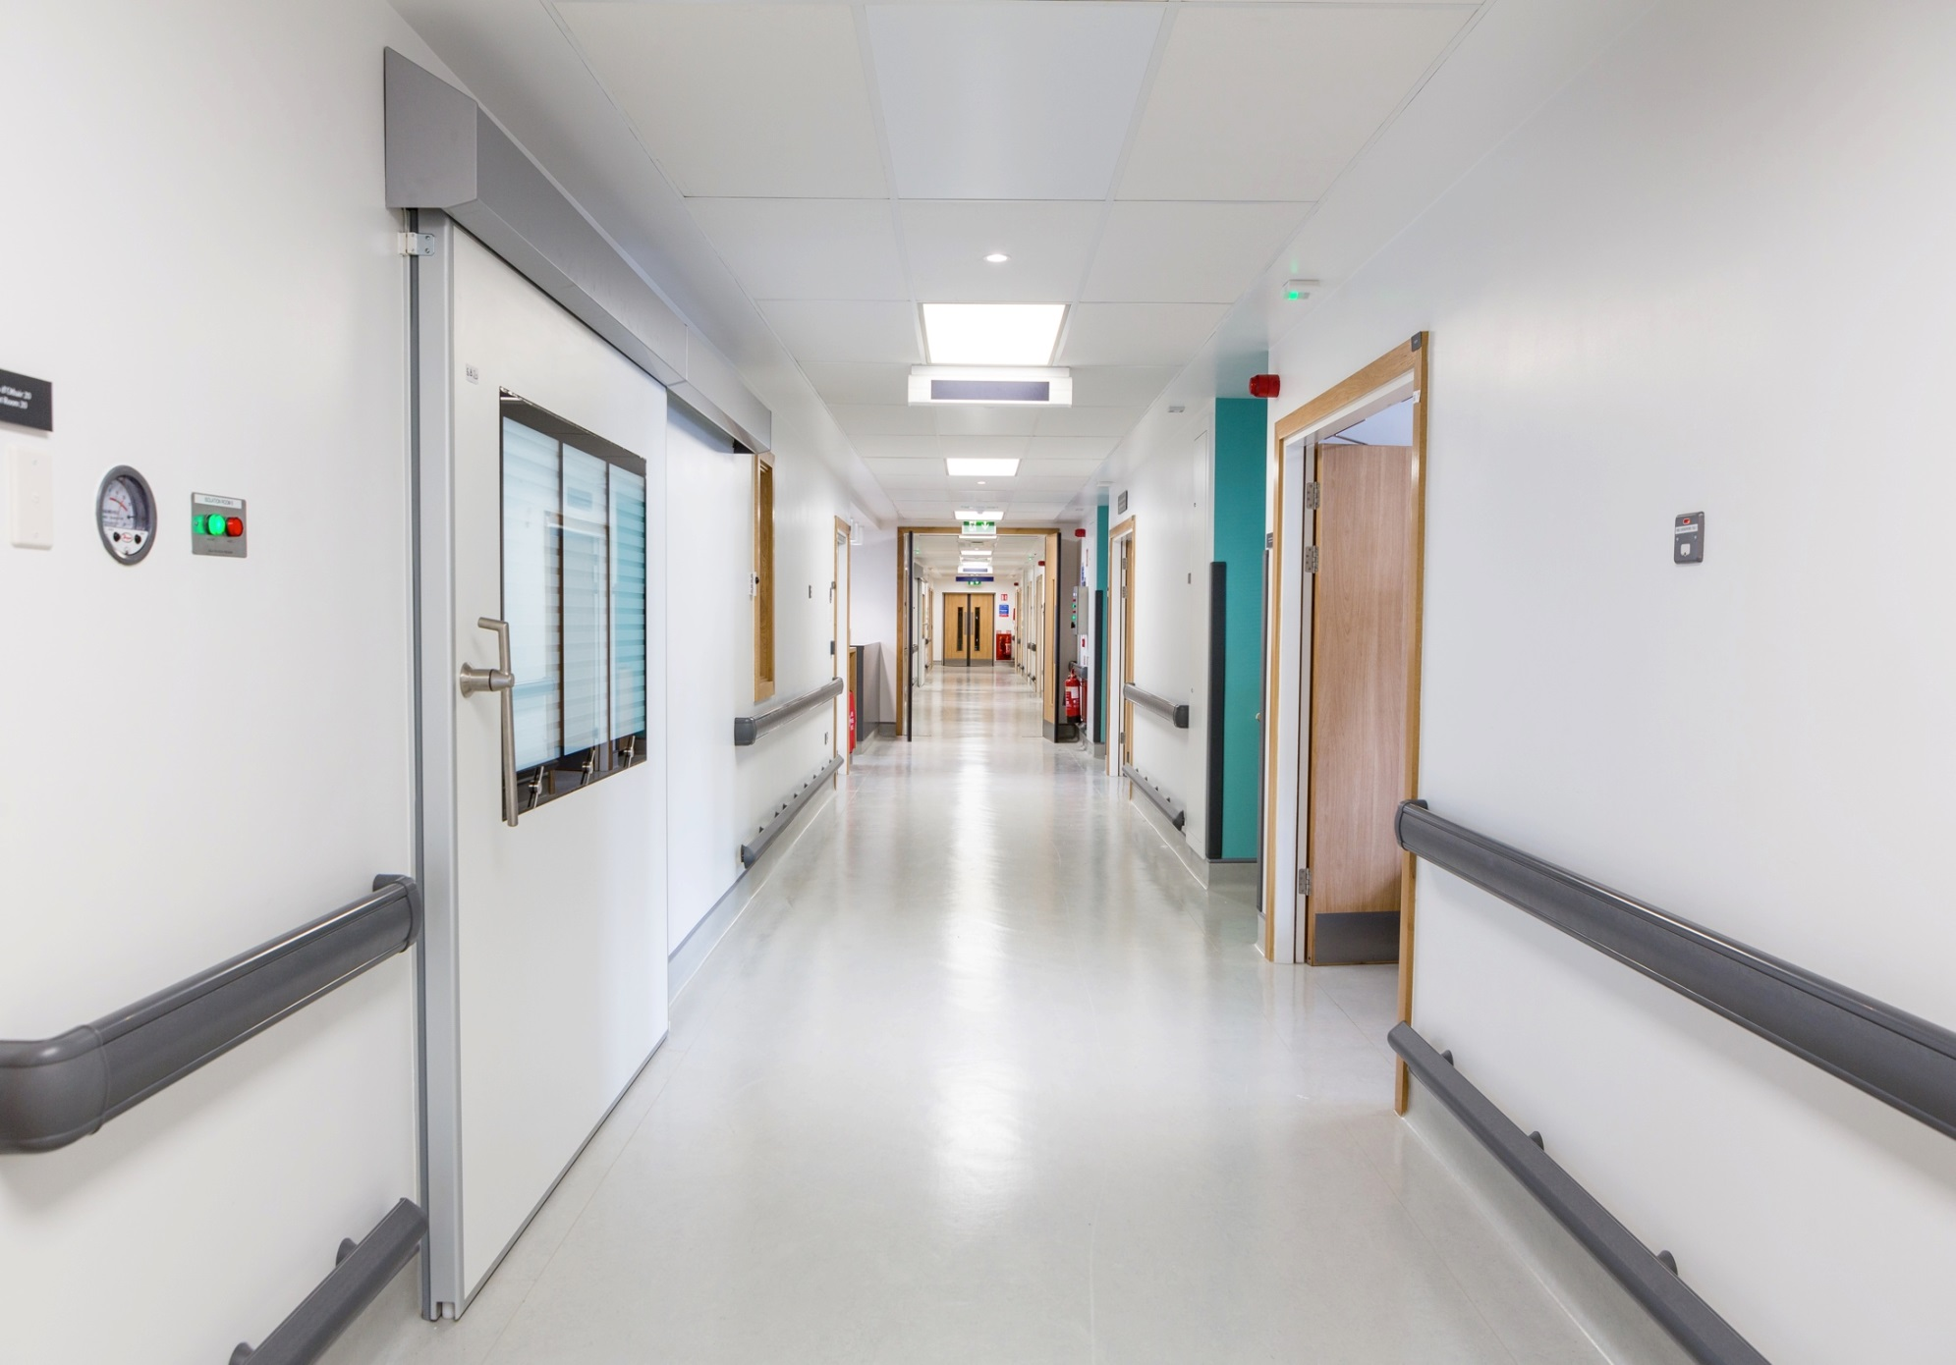

Slide 8
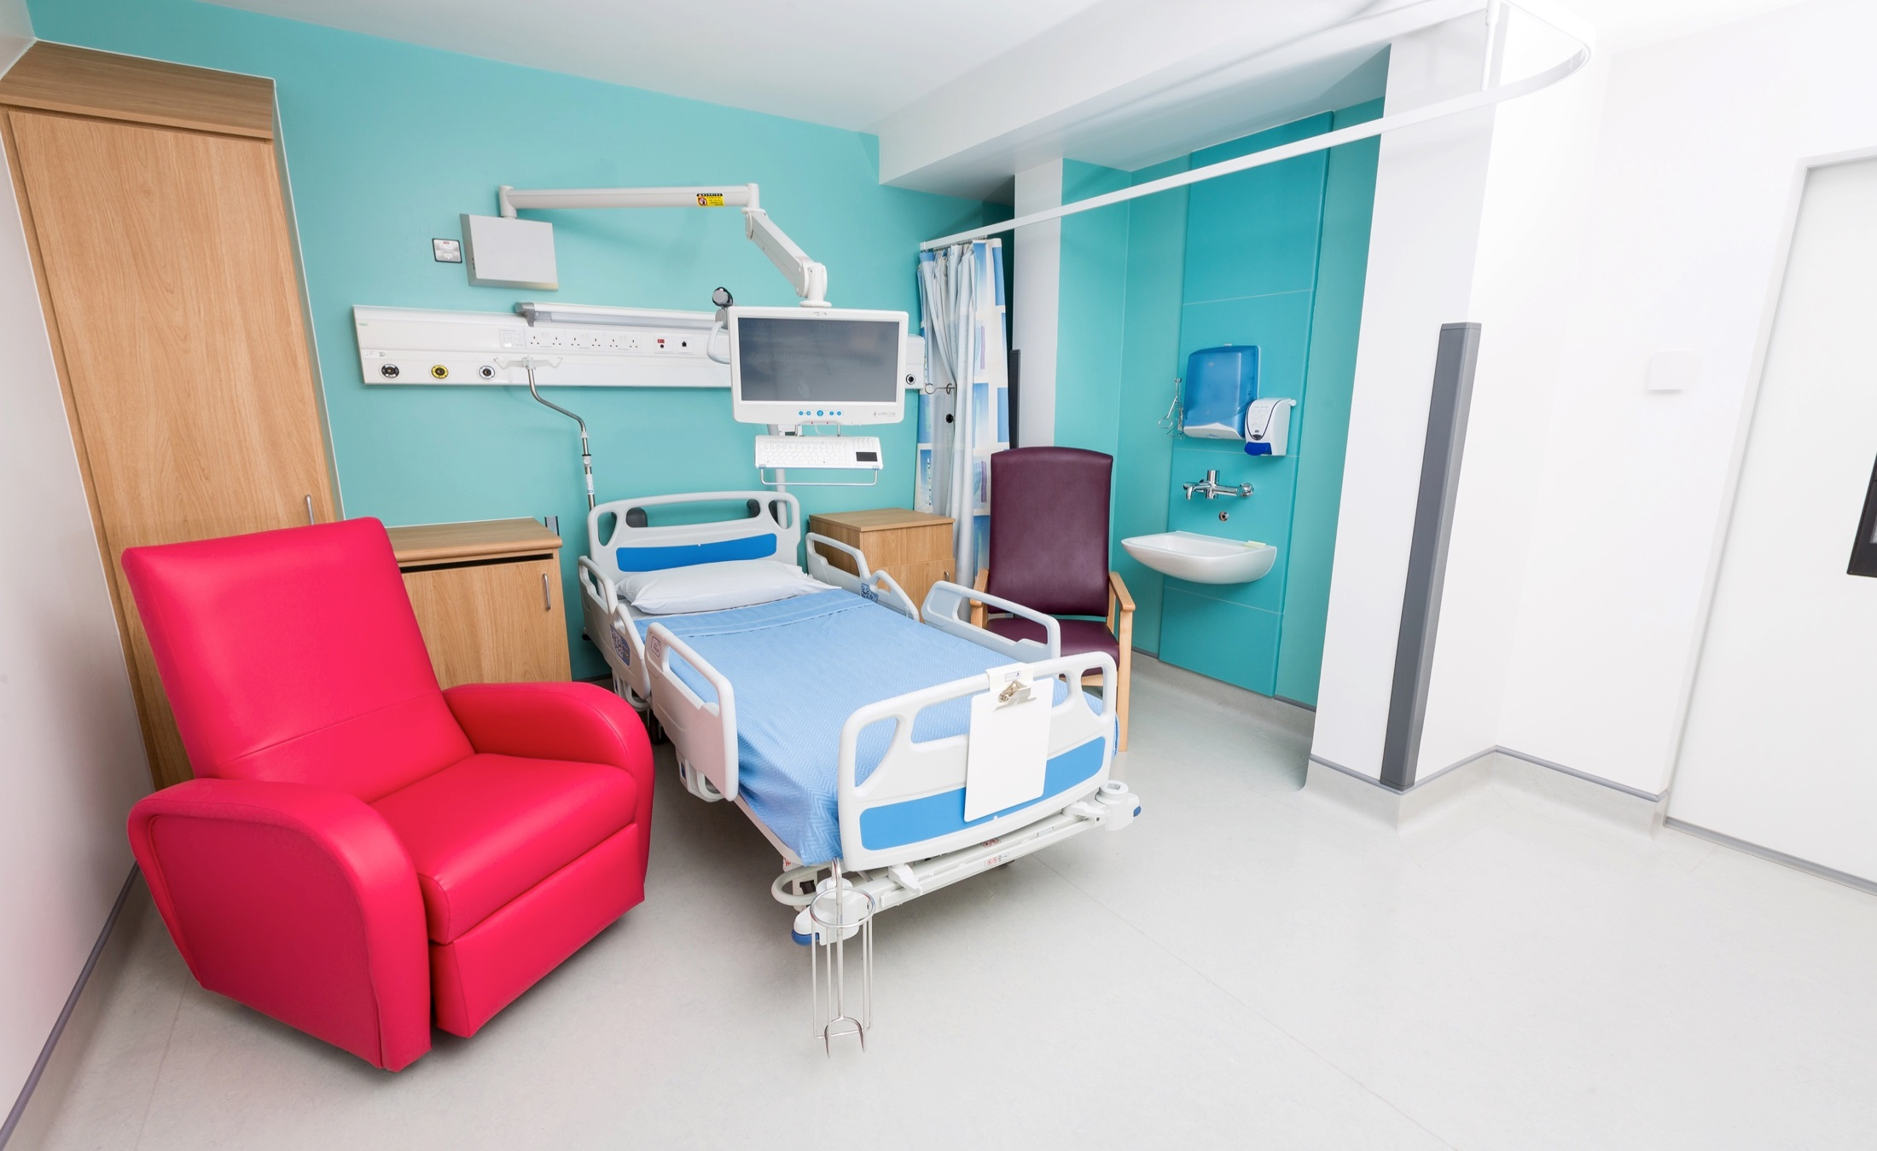
8 isolations rooms to HBN04-01 guidelines

Slide 9
Guidelines for patients
Irish cystic fibrosis association
Cystic fibrosis thrust foundation
American Cystic fibrosis Foundation

Slide 10
What not to do
Do not spit on the ground
Do not share drinking utensils
Do not share food or drinks or toys
Do not get involved in preparing food if other CF are going to be present
Do not share medical devices
Cover your mouth and nose whenever you cough and preferable using a tissue which can be disposed of in a sealed container

Slide 11
Prolonged contact with other people with CF
Avoid being together in enclosed or poorly ventilated places. Such as travelling in a car or coach or in a pub may introduce a higher level of risk
Do not travel to an event with others with CF unless you share a house eg parent brother sister or child or partner who also has cystic fibrosis
After attending any event and after shaking hands with another individual whether or not they have CF
Get vaccinated
Observe basic hygiene- hand washing before and after meals
Wearing a mask

Slide 12
Indoor events
Cross infection is more likely to occur at indoor events
If an event is organised that needs a PWCF to attend policy of CF Ireland and CF thrust –only one person attends
Some adults continue to meet despite the risk of cross infection–they have to be Cepacia and Mrsa free

Slide 13
Guidelines for CF at out door events
Those with Burkholderia Cepacia should not attend any event where anyone with cystic fibrosis is present.
Some strains are more serious than others and there are several strains
Safe 6 foot away from other CF (CF foundation Americian)
Regular hand washing or use of alcohol based hand gel

Slide 14
Care of equipment
Accupella
envoiroment
Flutter
Bipap
E-flow
nebulizer

Slide 15
Advice
Important to keep nebulizers clean and dry
After each use disconnect nebulizer mouth piece and turn nebulizer on for a few seconds to clear moisture from tubing
Wash nebuliser mouth piece in soapy warm water
Dry thoroughly
Never use a brush to clean
Never immerse the tubing in water
Nebulizer mouth pieces should be boiled with 2 drops of washing up liquid for 6-10 minutes one a week
Air dry all equipment

Slide 16
Compressor
Don’t put compressor on the floor as dust can be drawn in to the machine
Wipe compressor with a damp cloth to keep it dust free
Inlet filter should be changed every 3 months
Compressor needs to be serviced yearly
If using a filter for nebulized antibiotics it must be changed after use
Baby sterilization unit are also used sterilize chambers

Slide 17
Bacterial contamination of Cf CLINICS (Zuckerman JB et al journal of Cystic Fibrosi2009)
Study done in several centres demonstrated a measurable contamination rate of
patients hands
Clinic environment
It also found that the use of alcohol based hand hygiene products reduces the carriage of respiratory pathogens on hands

Slide 18
Cork university hospital
Patients attend clinic and day unit according to microbiology status
Staphlococcus aureus come first
Pseudomonas aeruginosa positive second
Stenotrophomonas maltophilia
Mrsa
Burkholderia Cepacia
Non Tububerculous mycobacteria

Slide 19
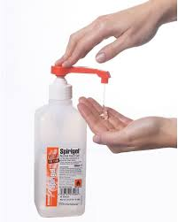

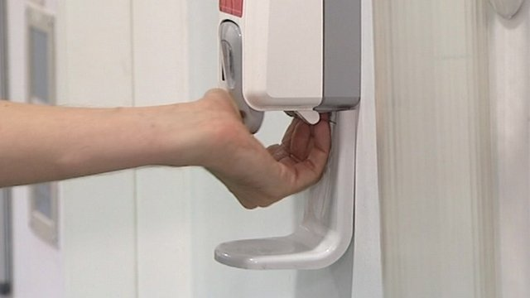
Importance of hand hygiene for all

Slide 20
Patients attending outpatient clinic
Patients are sent a text 2 days prior to appointment and given a time
5 single out patients facility
Mrsa Burk cepacia NtM
Room kept free for 24 to 48 hours
Patients are allocated room according to their microbiology

Slide 21
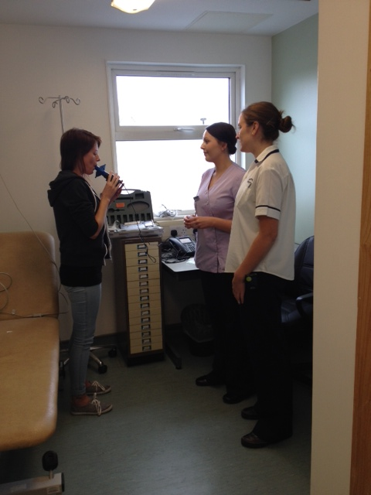
Lung function
Bacterial filters
Different spirometry head are used for Mrsa/Cepacia/Ntm

Slide 22
Transplant patients
Pre transplant –advised re general hygiene and infection control measures
Post transplant-general hygiene
Avoid crowded places
Avoid people with colds and flues
Avoid children particularly if out break of chicken pox
Avoid hand shaking and close contact

Slide 23
Living with BC is difficult for the patient
Anxiety and anger are aroused with those who have Cepacia when infection control measures are introduced (UK CF Trust 2009)
Study done by Smallman E a clinical psychologist that patients characterised their experience of living with BC identified three main themes

Slide 24
As loss of identity- that B cepacia can challenge one’s identity and leave one feeling alienated by CF group identity
Status condemned- being colonised with BC brings with it the knowledge of a certain type of restricted future and an imagined earlier death. There is a loss of hope and normality.
I am Cepacia –making decisions about preventing cross infection is influenced by medical knowledge as well as human emotions and social information.
Responsibility for cross infection is a burden and requires knowledge and understanding for both those with it and without

Slide 25
How this information is given can affect how patients copes with it

Slide 26
Air sterilization/disinfection system
The in line air sterilization unit utilizes Active Pure technology consisting of Special UV lightening and photocatalyst equipment which creates an advanced D oxidation process containing several oxidizers.
This system substantially reduces odours and microbial population
Aim of this is to provide clean air to a high standard for our CF Unit

Slide 27
Conclusion
Infection control is of paramount importance in the care of patients with cystic fibrosis
Education of all health professionals involved in the care of PWCF
Patients should be aware of the bugs that they grew to ensure they take the necessary precautions
Basic hygiene should be started at a young age
Hand washing

Slide 28
Home Intravenous Antibiotics
Main responsibility of Cystic Fibrosis Nurse Specialist is education of patients to administrate intravenous antibiotics
Role of the Cystic Fibrosis nurse is central to an effective and satisfactory Home intravenous Therapy Service
Organisation of intravenous antibiotics in the home
Ensuring safe administration in the home
Ensuring patient safety

Slide 29
Many studies have shown that home intravenous antibiotic therapy
Is a practical, effective and acceptable alternative to hospital treatment for many patients (Gilbert et al 1988. Peckham & Knox 1993; Pond et al 1994; Reithmuller et al 2002)

Slide 30
Patients should always be given the choice
Home or hospital

Slide 31
Advantages
Patient can be in their own home
Can reduce demands on family with hospitals visits
Can continue with their education
Can continue with their employment
Cross infection
Cost effective

Slide 32
Factors to be considered
Can be too demanding on patient and family
May not have the necessary support at home
Too ill at the time
Additional supports of multi disciplinary team may not be available
Isolation
Does the patient have a good understanding of the responsibilities and risks of being on home intravenous therapy

Slide 33
Type of venous access
Cannula
Midline
Portacath inserted when difficulty inserting midline
Pic line

Slide 34
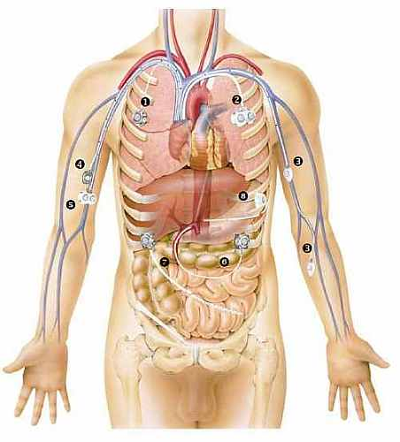
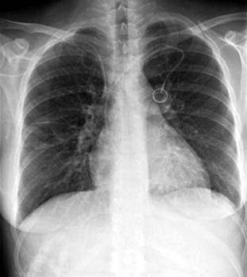
portacath

Slide 35
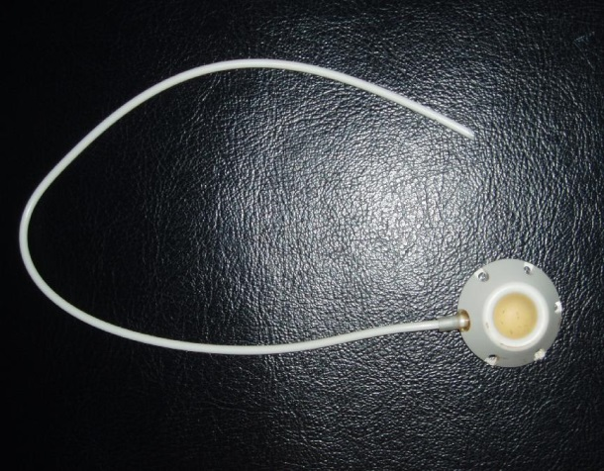
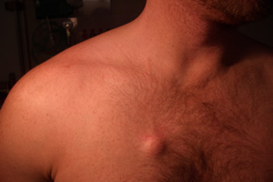
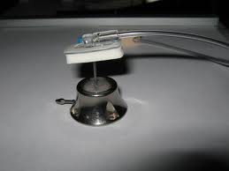
portacath

Slide 36
Complications portacath
Pneumothorax may occur following insertion
Infection at site
Catheter infection bacterial/fungal
Swelling at port site
Occlusion
Skin irritation
Rupture of skin around port

Slide 37
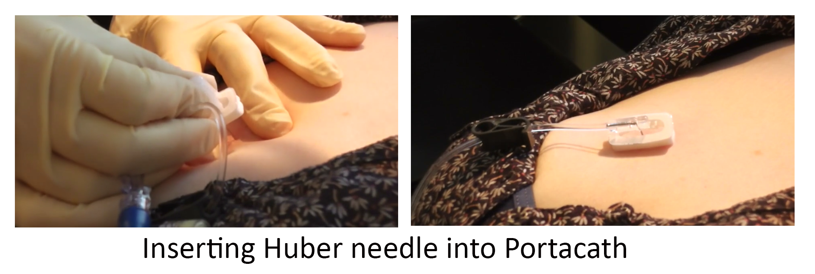

Slide 38
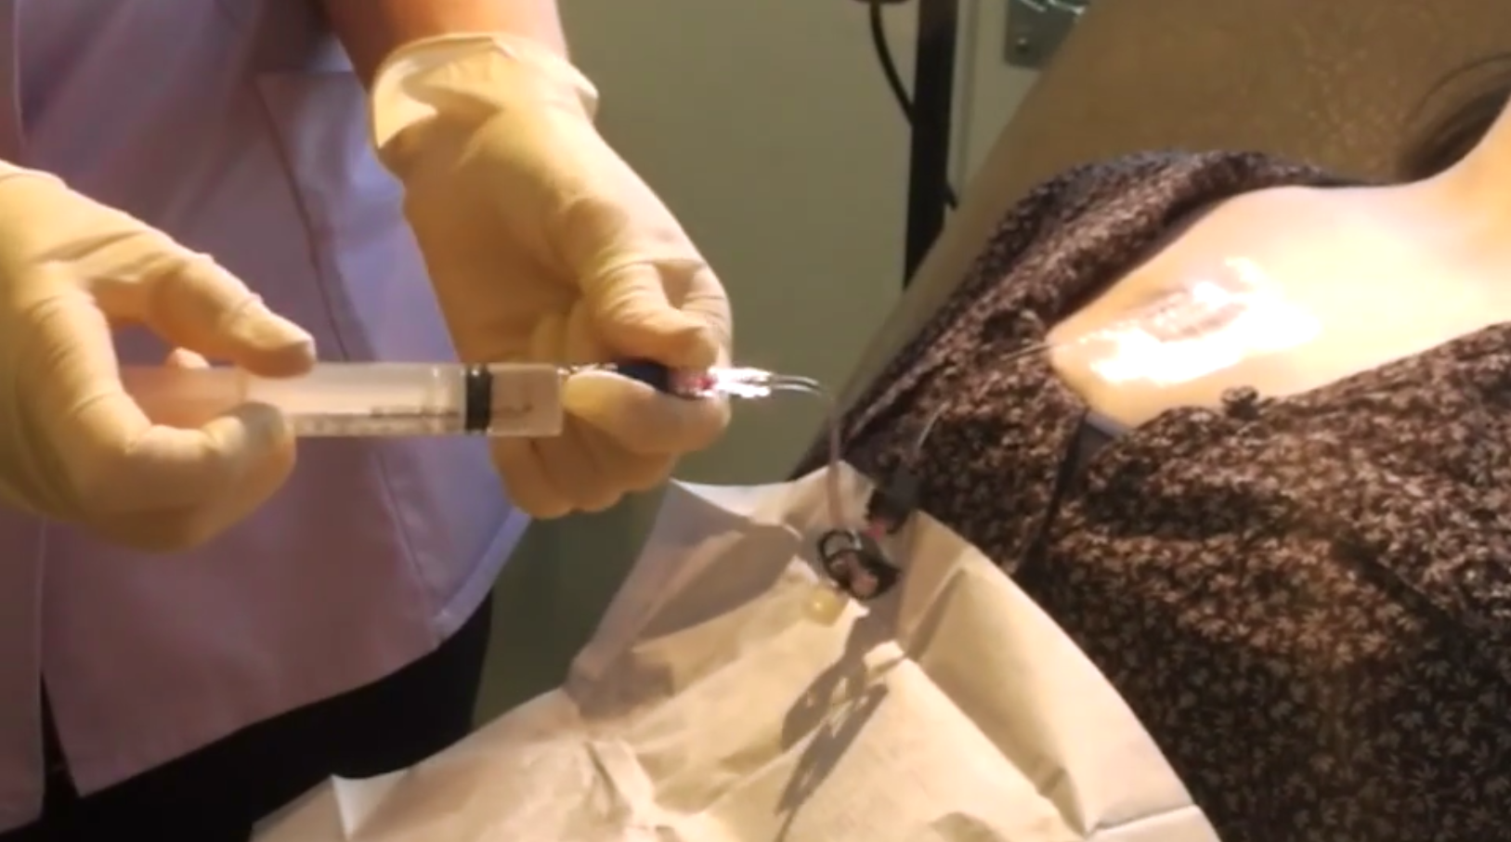
Flushing port

Slide 39
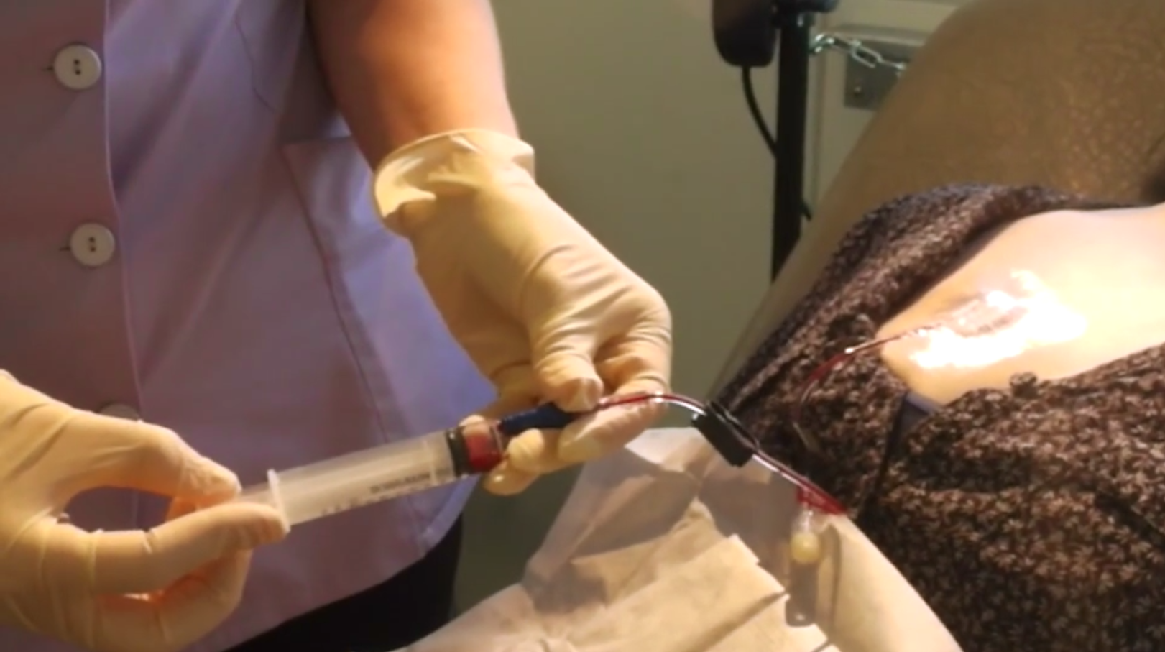
Taking blood

Slide 40
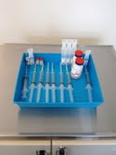
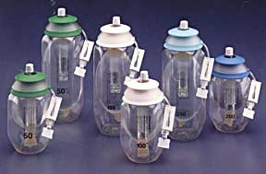
Administration of I/V
Bolus
Via pumps prepared by drug
company

Slide 41
First dose is all ways given in the hospital setting
If previous hyper-sensivity to drug second dose is given too

Slide 42
When to call
Rash
Nausea
Severe diarrhoea
Any unusual symptoms
Swelling

Slide 43
During course of antibiotics
Check FBC Bioprofile and Crp
Lung function
Weight
Home or hospital
Monitor drug levels –tobramycin

Slide 44
Severe reaction is rare
Sudden collapse or illness
Severe difficulty with breathing
Swelling of neck

Slide 45
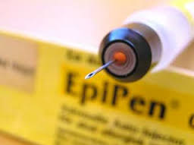
You will have training in the use of Anaphylaxis kit
You and a member of your family or partner
Piriton and Prednislone oral
Pirition and Hydrocortisone intravenous
Epipen

Slide 46
Successful home programme
Education programme tailored to individual needs
Patient at any time if not improving can be admitted
Adequate support from Cystic fibrosis clinical nurse
Home visits or hospital to access condition
In an emergency situation be able to contact relevant people
Physiotherapy visit

Slide 47
Vă mulțumim pentru atenție

